Slide 1
Car Seat Safety

Slide 2
Facts about Car Seat Safety
Motor vehicle crashes are the number one cause of death in children
90% of car seats are not installed properly, in Wisconsin
95% of car seats are misused on the first trip home from the hospital

Slide 3
Wisconsin Car Seat Law
Rear Facing:
Children less than one year and who weigh less than 20 pounds must be in a rear-facing car seat in the back seat of the vehicle
Forward Facing:
Children one- four years old that weigh at least 20 pounds must be in a forward facing car seat with a harness until they are four years old or 40 pounds in the back seat of the vehicle
Booster:
Children who are four- eight must be in a booster until they are eight years old, weigh 80 pounds or are 4’9” in the back seat of the vehicle

Slide 4
Rear Facing is the BEST!
Little to no force is applied to the head, neck or spine
The car seat helps cradle the head, neck and torso
Helps keep the child properly aligned and spreads the crash forces across the entire body

Slide 5
Rear Facing Recommendation:
Children should be rear facing until at least two years old or until they meet the height OR weight requirements of the car seat

Slide 6
States the REQUIRE rear facing until two years old:
California
Connecticut
Illinois
Louisiana
Nebraska
New Jersey
New York
Oklahoma
Oregon
Pennsylvania
South Carolina
South Dakota
Virginia
Washington
**Other States are in the process of passing similar laws
**Know the laws if you are traveling

Slide 7
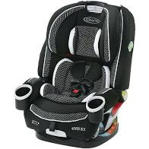
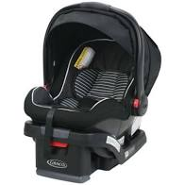
Choosing a Car Seat
Fits the CHILD properly
Fits the CAR properly
Will be used correctly EVERY TIME
No recalls, you know the history of the seat and the expiration date of the seat
Always read the labels on the car seat and the owner’s manual
Always read the vehicle manual

Slide 8
Infant Carrier vs. Convertible Car Seat

Slide 9
Infant Carrier
Fits babies for about the first year
Light weight
Has a handle for easy carrying
Snaps in and out of the base and stroller
Rear facing only
Can be taken in and out of the vehicle easily

Slide 10
Convertible Car Seat
Rear facing to forward facing
Heavier than infant only car seats
Usually are more expensive
Cannot be taken in and out of the vehicle easily

Slide 11
Where to Install a Car Seat in the Vehicle
Any spot in the rear seat is safe
NEVER install a car seat in the front seat
Air bags can cause serious injury or even death

Slide 12
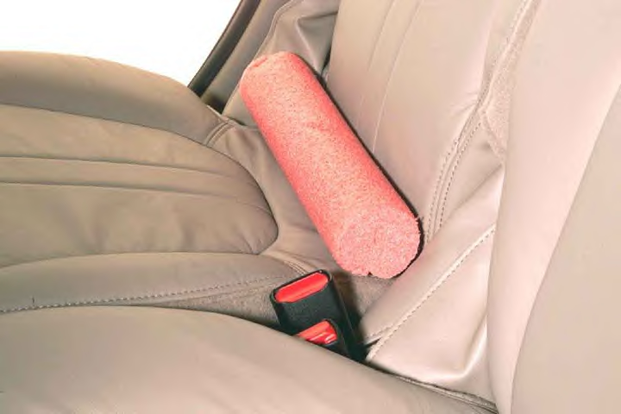
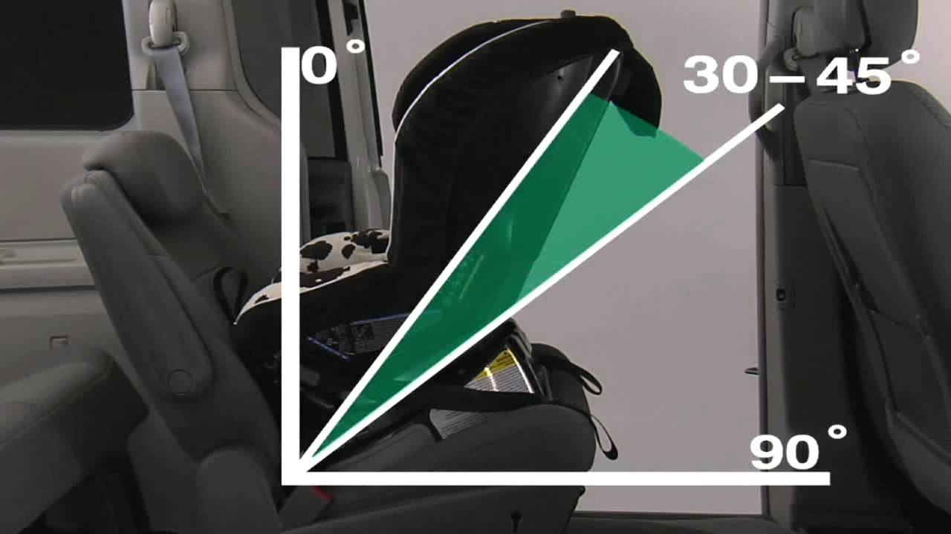
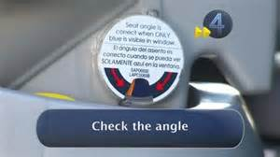
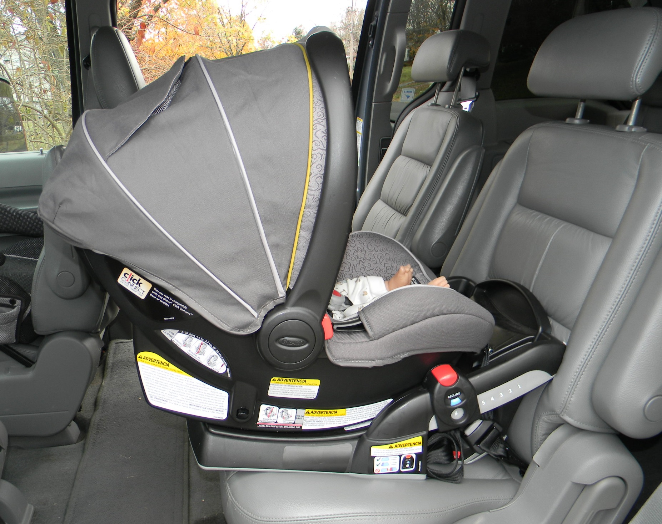
Installation of Car Seats
The car seat should be installed at a 30-45 degree angle
Read the car seat owners manual regarding the amount of overhang allowed for every car seat

Slide 13
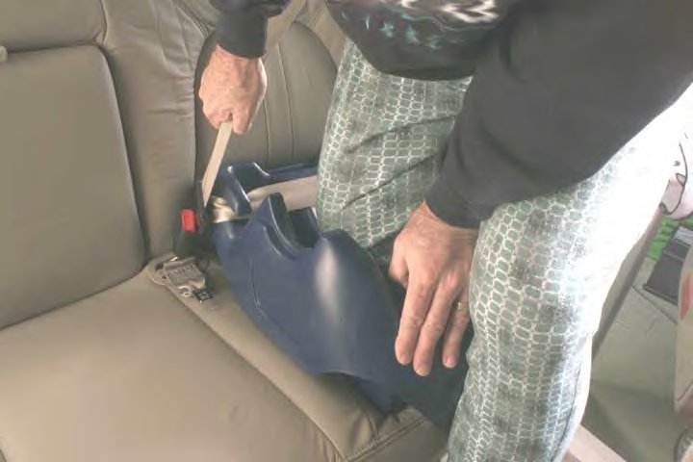
Installation of Car Seats
The seat should fit tightly in the car
Seat should not move more than 1 INCH at the belt path when installed
**Tip: put your weight into the seat**
The straps should not be twisted

Slide 14
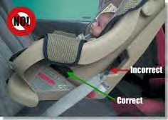
Belt Path
Convertible car seats have two belt paths; rear facing and forward facing
**Make sure you have the right path for the direction the seat is facing**

Slide 15
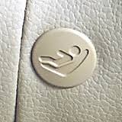
Lower Anchors
Use one or the other- Lower anchors or vehicle seat belt
Some rear center seats don’t have lower anchors
Read the vehicle and car seat owner’s manual to see if sharing of an anchor from both the left and right side is allowed

Slide 16
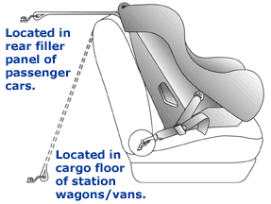
Tether Strap
Used on forward facing car seats only
Adds stability to the car seat
Reduces head excursion

Slide 17
Harness and Chest Clip Facts
Misused 50% of the time
They are critical to minimize head and neck injury
If the chest clip is too low even with a tight harness the child could still move forward more than expected and increase the risk for head and neck injuries

Slide 18
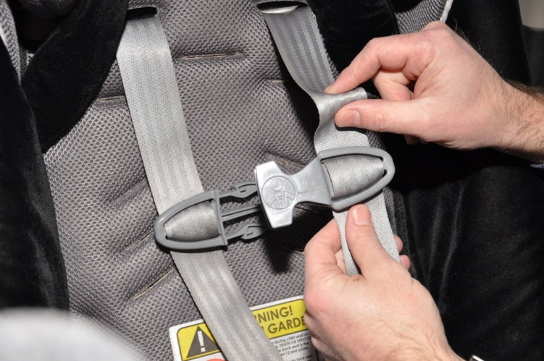
Harness
Rear facing: Harness should be at or below the shoulders
Forward facing: harness should be at or above the shoulders
You should not be able to “pinch” the straps together
DO NOT use extra padding and blankets behind or under the harness

Slide 19
Make sure the Harness is not Twisted!
Twisted straps won't distribute crash forces as intended.
If you take a wide, flat belt, put it around your arm and pull firmly, the force is evenly distributed and it won't hurt or leave a mark.
Now, do the same with a rope. The rope will cut into your arm and leave a mark with much less force than a wide belt.
The same holds true for car seat straps, except that the force is much greater in an accident.

Slide 20
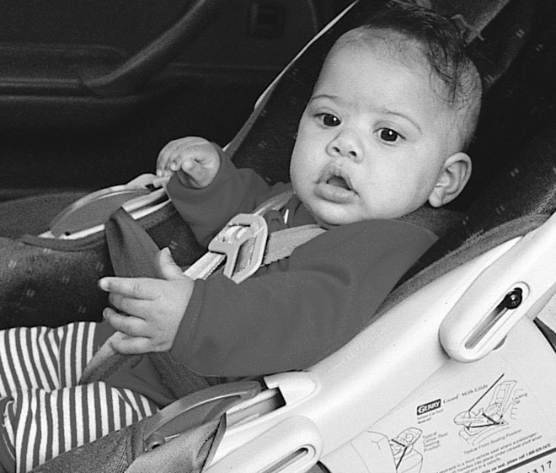
Chest Clip
Chest clip should be at armpit level

Slide 21
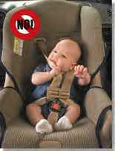
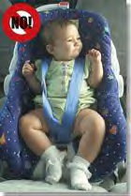
Never keep the harness loose, above the shoulders or chest clip below armpit level

Slide 22
Winter Coats

Slide 23
Winter Coats
Affect how secure your child is in the car seat
Impossible to get the harness snug
Even though the harness may feel snug when in a crash the material compresses against the child making the harness too loose

Slide 24
How do I keep my child warm?
Dress your child in warm layers
Ex: nothing thicker than a fleece Columbia sweatshirt
After you child is secure in the car seat place a blanket over them
For older children, once they are secure in the car seat you can put their coats on backwards

Slide 25
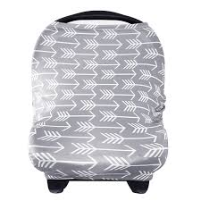
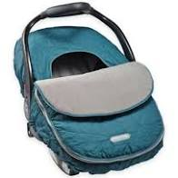
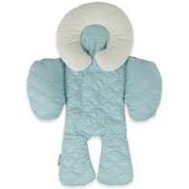
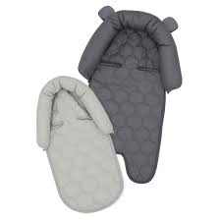
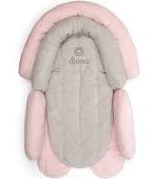
After Market Products
Not recommended unless the product comes with the car seat and has been crash tested
Check the car seat owner’s manual for use

Slide 26
Reminder:
Send in the registration card for the car seat
Recall information will be sent to you
Replace any car seat involved in a crash
Do not use a car seat without knowing the history

Slide 27
Read the vehicles owner manual and car seat owners manual
Have your base/car seat installed ahead of time
A Certified Car Seat Technician can help
Call Tomah Health’s, Women’s Health Department to Schedule an appointment at 608-377-8400
Contact a local Police Department, Ambulance Service or Fire Station (not every agency may have someone certified)
Getting Ready for the “big day”

